Slide 1

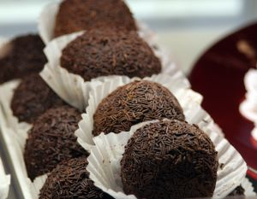

PREPARE CHOCOLATE AND PRODUCE CHOCOLATE PRODUCTS
D1.HCC.CL2.13 D1.HPA.CL4.05
Notes:
Trainer welcome trainees to class and informs that they will be learning how to “Prepare chocolate and produce chocolate products”.

Slide 2

Prepare chocolate and produce chocolate products
Assessment for this Unit may include:
Oral questions
Written questions
Work projects
Workplace observation of practical skills
Practical exercises
Formal report from employer/supervisor
Notes:
Trainer advises students that assessment for this Unit may take several forms all of which are aimed at verifying they have achieved competency for the Unit as required.
Trainer indicates to students the methods of assessment that will be applied to them for this Unit.

Slide 3
Prepare chocolate and produce chocolate products
This unit comprises six elements:
Temper couverture
Prepare chocolate based fillings, coatings and decorations
Prepare chocolate moulds
Make moulded chocolates
Coat and decorate with chocolate
Store chocolate and chocolate products
Notes:
Trainer advises students this Unit comprises six elements, as listed on the slide explaining:
Each Element comprises a number of Performance Criteria which will be identified throughout the class and explained in detail
Students can obtain more detail from their Trainee Manual
The course presents advice and information but where their workplace requirements differ to what is presented, the workplace practices and standards must be observed.

Slide 4

Prepare chocolate and produce chocolate products
Element 1: Temper chocolate:
Melt and temper couverture using correct techniques and temperatures
Maintain tempered couverture for use
Notes:
Trainer to relate performance criteria to element 1
Performance criteria is the process by which the students training match the learning element
The element is the skill
To assess competency in the skill; the performance criteria is used to outline activities that can be used to assess competency.
The trainer should relate how the performance criteria is related to the element
To be able to Prepare chocolate and produce chocolate products the students must be able to; Temper chocolate
The student should be able to do
Melt and temper couverture using correct techniques and temperatures
Maintain tempered couverture for use

Slide 5
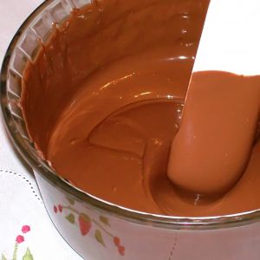
Temper chocolate
Melt and temper couverture:
Cut into small pieces or use chocolate pellets
Heat slowly over warm water
Stir with clean dry utensil
No more then 50°C
Keep water away from chocolate
Use clean equipment
Notes:
Trainer to advise:
Cut into small pieces
The faster the chocolate melts the better
Small pieces will melt quicker than larger pieces
Place chocolate into clean DRY container
Allow steam to warm the container that holds the chocolate: DO NOT allow water to touch the container

Slide 6
Temper couverture
Melt and Temper chocolate:
Dark Chocolate ⬆45° ⬇28° 32°☑
Milk Chocolate ⬆45° ⬇27° 30°☑
White chocolate ⬆45° ⬇26° 29°☑
Compound chocolate no more than 40°☑
Notes:
Trainer to advise:
Temperature range to be measured when tempering chocolate
Use digital thermometer
Stir slowly

Slide 7
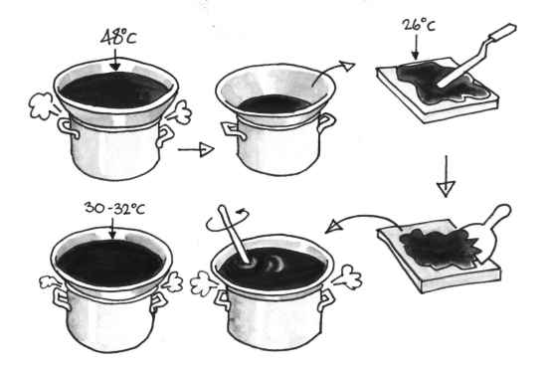
Temper couverture
Maintain tempered couverture for use:
Insulate container to retain warmth
Use warmed cloth around bowl
Place into chocolate warming bain marie to hold at static 30°C or less
Notes:
Trainer to advise:
Working in colder climates like Europe and Southern Australia air temperature can be as low as 15ºC to 18ºC in workplaces.
It is important to keep the tempered chocolate at a working temperature of 28ºC to 30ºC
Static warmers; these are basically warm bain maries using dry electric elements inside a box to keep temperature at a constant temperature
These are available in various sizes: Contact specialist chocolate supplier
There are now machines that will temper for the confectioner but these take longer time than what can be achieved by hand

Slide 8
Prepare chocolate and produce chocolate products
Element 2: Prepare chocolate based fillings, coatings and decorations:
Select required commodities according to recipe and production requirements
Use appropriate equipment to prepare chocolate based fillings, coatings and decorations
Use correct techniques to produce chocolate based fillings, coatings and decorations to enterprise standards
Produce chocolate based fillings/centres, coatings and decorations to enterprise requirements and standards
Notes:
Trainer to advise:
Trainer to relate performance criteria to element 2
Performance criteria is the process by which the students training match the learning element
The element is the skill
To assess competency in the skill; the performance criteria is used to outline activities that can be used to assess competency.
The trainer should relate how the performance criteria is related to the element
To be able to Prepare chocolate and produce chocolate products the students must be able to; Prepare chocolate based fillings, coatings and decorations
The student should be able to do
Select required commodities according to recipe and production requirements
Use appropriate equipment to prepare chocolate based fillings, coatings and decorations
Use correct techniques to produce chocolate based fillings, coatings and decorations to enterprise standards
Produce chocolate based fillings/centres, coatings and decorations to enterprise requirements and standards

Slide 9
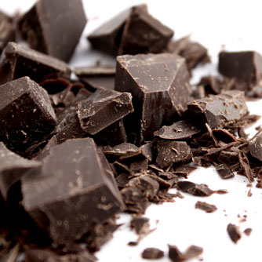
Prepare chocolate based fillings, coatings and decorations
Select required commodities:
Compound chocolate looks very similar to couverture
Keep labeling with all products
Follow standard recipe ingredients
Collect all ingredients before beginning the production process
Notes:
Trainer to advise:
Confectioners need to be able to identify quality products
Compound chocolates are similar to couverture
Remember: couverture is the better product with excellent mouth feel and longer flavour structures in the mouth after consumption
All product must have a standard recipe; this keeps the consistency in the product
The customers want the same product as they purchased last time

Slide 10
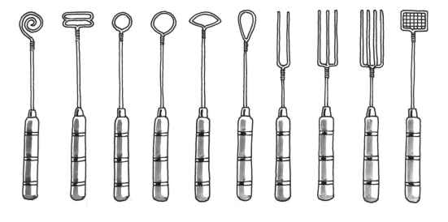
Prepare chocolate based fillings, coatings and decorations
Use appropriate equipment to prepare fillings:
Equipment must be clean
Stainless steel is recommended
Equipment must be dry
Equipment must be suitable to the job
Notes:
Trainer to advise:
Even the small equipment must be suitable for the job
Example:
Do not try to stir the chocolate with a small spoon
Use a good size spoon that is clean
It must not be a spoon that has been used to stir savoury foods and is embedded with taste of garlic and onions for example

Slide 11
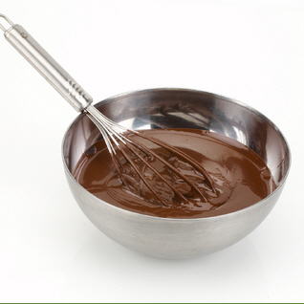
Prepare chocolate based fillings, coatings and decorations
Use correct technique to produce fillings:
Whisk
Combining chocolate and cream for ganache
Blend slowly
Stirring chocolate while it is melting
Pipe consistent sizes
Piping truffles to be sold individually requires them to be same size
Enrobe
Complete coverage of soft centers
Notes:
Trainer to advise:
The skills used by the confectioner is the same as the patissier
Blend
Whisk
Enrobe
Piping
Many skills are required but the most important is ‘patience’
All steps must be followed
If shortcuts are used then product quality will be compromised

Slide 12
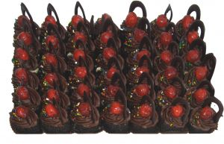
Prepare chocolate based fillings, coatings and decorations
Produce to enterprise standards:
Enterprise standards will vary
Use best quality ingredients
Follow standard recipe
Notes:
Trainer to advise:
Enterprises will have varying standards
What is the market place that is being supplied
High quality; the best ingredients and flavourings
Budget quality; good quality ingredients
It will vary…

Slide 13
Prepare chocolate and produce chocolate products
Element 3: Prepare chocolate moulds
Ensure moulds are clean
Polish moulds ready for use
Moulds are kept at correct temperature for production
Notes:
Trainer to advise:
Trainer to relate performance criteria to element 3
Performance criteria is the process by which the students training match the learning element
The element is the skill
To assess competency in the skill; the performance criteria is used to outline activities that can be used to assess competency.
The trainer should relate how the performance criteria is related to the element
To be able to Prepare chocolate and produce chocolate products the students must be able to; Prepare chocolate moulds
The student should
Ensure moulds are clean
Polish moulds ready for use
Keep Moulds at correct temperature for production

Slide 14

Prepare chocolate moulds
Ensure moulds are clean
Moulds need to be clean
Clean with soft cloth
Do not use knife or sharp object to rush job
Imperfection will cause chocolate to stick and show on moulded product
Wash:
Only use hot water and soft cloth
Dry thoroughly
Notes:
Trainer to advise:
Any imperfection on inside of mould will show as an imperfection on moulded chocolate when it is demoulded
Do not scrape or scratch cold chocolate from mould
Wash in hot water and mild detergent; rinse in hot water
Use soft cloth to wipe chocolate from mould
Air dry
Use hair dryer if required

Slide 15

Prepare chocolate moulds
Polish moulds ready for use
Use soft cloth
Smooths the surface ready for tempered chocolate
Notes:
Trainer to advise:
Polish with clean soft cloth
If surface is clean the chocolate will release from the surface when it contracts
The product will then release from mould more easily.

Slide 16
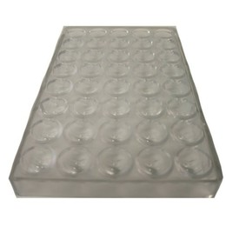
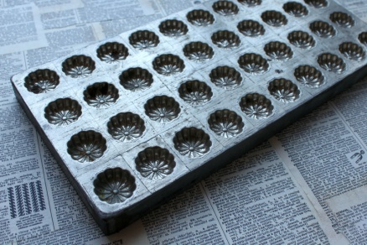
Prepare chocolate moulds
Keep moulds at correct temperature for production
Polycarbonate - 20ºC
Metal - 25ºC
Best kept in dry warmed storage box
Important in cooler climates; not in tropics
Notes:
Trainer to advise:
If the moulds are too cold the chocolate will thicken too quickly;
especially when doing filled chocolates and when tipped over the shell will be too thick and not be able to hold enough filling
Keep moulds in secure storage to will minimise chance of damage

Slide 17
Prepare chocolate and produce chocolate products
Element 4: Make moulded chocolates
Select and prepare combinations to be produced
Use tempered couverture and set in moulds correctly
Fill moulded chocolates correctly
Set, release and handle moulded chocolates appropriately
Notes:
Trainer to advise:
Trainer to relate performance criteria to element 4
Performance criteria is the process by which the students training match the learning element
The element is the skill
To assess competency in the skill; the performance criteria is used to outline activities that can be used to assess competency.
The trainer should relate how the performance criteria is related to the element
To be able to Prepare chocolate and produce chocolate products the students must be able to: Make moulded chocolates
The student should be able to do
Select and prepare combinations to be produced
Use tempered couverture and set in moulds correctly
Fill moulded chocolates correctly
Set, release and handle moulded chocolates appropriately

Slide 18

Make moulded chocolates
Select and prepare combinations of choice
Personal taste
What will customers like?
Select quality ingredients
Prepare with care
Notes:
Trainer to advise:
Confectioners need to produce product that will sell
Use combinations that are known to work and have been sold before
Be adventurous with some flavour combinations
Chilli chocolate was not used 30 years ago but is now popular in Australia.
Not a big market BUT the flavour combination is enjoyed by some people
Student Activity
Ask the students to work on flavour combinations
Who has eaten chilli chocolate????

Slide 19
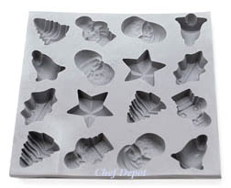
Make moulded chocolates
Fill moulded chocolates correctly
Use warmed moulds
Use tempered couverture
Fill moulds
Tap gently to release air bubbles
Roll over to release excess chocolate and drain
Scrape mould level; allow to set
Notes:
Trainer to advise:
With properly prepared moulds and correctly tempered couverture
Fill moulds with couverture
Tap mould gently on bench to all any air bubbles to move away from edges of moulds
Tip moulds over to allow excess couverture to drain out
When majority of couverture has drained, turn mould back upright
Scrape with PLASTIC scraper the base of moulded shell to give straight edge to chocolate base

Slide 20
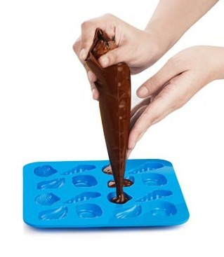
Make moulded chocolates
Fill moulded chocolates correctly
When set pipe filling into empty mould
DO NOT fill to top
Tap chocolate shell to settle filling
Top with tempered couverture
Smooth base level with bottom of mould
Notes:
Trainer to advise:
Filling of empty chocolate shell requires a fine tipped piping bag.
Do not fill the moulded chocolate
This is biggest mistake of beginners
Leave space for the remaining couverture base
The filling must be below the surface of the edge of the mould.
Pour couverture over the base
Smooth with flat plastic scraper to remove all excess chocolate from base

Slide 21
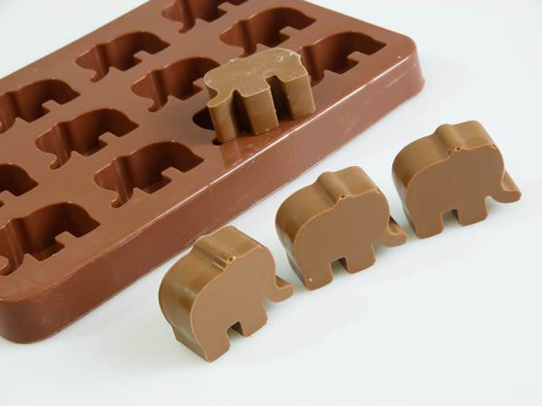
Make moulded chocolates
Set release and handle moulded chocolates
Allow for chocolate to set
Place into cool room for short period
Release
Tap gently on bench
Careful: do not do this to close to bench edge
(as they may fall onto the floor)
Notes:
Trainer to advise:
Set aside in cool space for chocolate to set and harden.
In warmer climates chocolate may need to be placed into coolroom for short period to set chocolate
When set , invert mould over papered bench and tap sharply on bench top to dislodge product from mould
Using a gloved hand place chocolate onto clean tray; place into covered storage space.

Slide 22

Make moulded chocolates
Set release and handle moulded chocolates
Handle de-moulded chocolates with gloved hands
Fingers leave oil mark on chocolate
Reject any chocolates that are dull in patches
Notes:
Trainer to advise:
When set , invert mould over papered bench and tap sharply on bench top to dislodge product from mould
Using a gloved hand place chocolate onto clean tray; place into covered storage space.
Any chocolates that show blemishes should be set aside and recycled.

Slide 23
Prepare chocolate and produce chocolate products
Element 5: Coat and decorate with chocolate:
Prepare a variety of chocolate coating, icing, glazes and decorations
Decorate using coating, icing, glazes and decorations according to standard recipes and or enterprise standards and or customer requests
Notes:
Trainer to advise:
Trainer to relate performance criteria to element 5
Performance criteria is the process by which the students training match the learning element
The element is the skill
To assess competency in the skill; the performance criteria is used to outline activities that can be used to assess competency.
The trainer should relate how the performance criteria is related to the element
To be able to Prepare chocolate and produce chocolate products the students must be able to; Coat and decorate chocolates
The student should be able to do
Prepare a variety of chocolate coating, icing, glazes and decorations
Decorate using coating, icing, glazes and decorations according to standard recipes and/or enterprise standards and/or customer requests

Slide 24
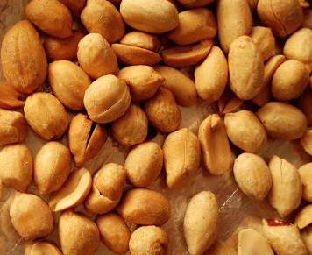
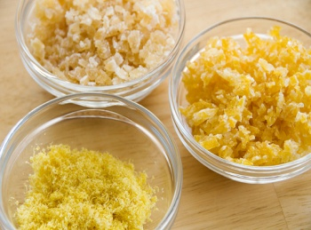
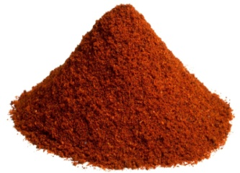
Coat and decorate with chocolate
Prepare variety of coatings, glazes and decorations:
Coloured
Flavoured
Roasted nut portions
Glace fruits
Crystallised fruits
Notes:
Trainer to advise:
Many variations exist for decorating finished chocolates
Basic rules:
Decoration must be edible
Decorations must be long lasting and not be affected by air dehydration; examples to use are glace fruits, nut portions, crystallised fruits
Decorations must not lose appearance by being exposed to air

Slide 25
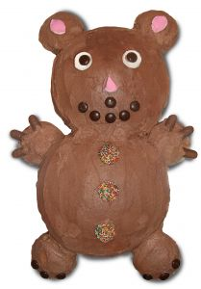
Coat and decorate with chocolate
Decorate to standard required:
Standards vary in enterprises
What is the role of product?
To be sold as individual chocolates
To be sold by weight
To be served as Friandise with coffee
Notes:
Trainer to advise:
Chocolates standard will vary due to the role that they will be required
If the are sold individually then they must all look the same
Sold by weight (by the kilo) then they may be slightly different in size
Maybe they are to be used as friandise with coffee.
Decoration will vary but should always compliment the flavour

Slide 26
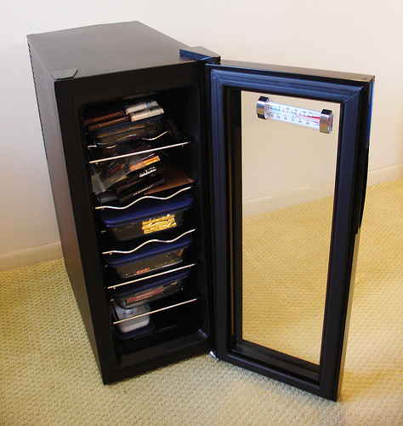
Prepare chocolate and produce chocolate products
Element 6: Store at correct temperature and conditions
Store at correct temperature and conditions
Maintain maximum eating quality, appearance and freshness
Notes:
Trainer to advise:
Trainer to relate performance criteria to element 6
Performance criteria is the process by which the students training match the learning element
The element is the skill
To assess competency in the skill; the performance criteria is used to outline activities that can be used to assess competency.
The trainer should relate how the performance criteria is related to the element
To be able to Prepare chocolate and produce chocolate products the students must be able to; Store chocolate at correct temperature and conditions
The student should be able to do
Store at correct temperature and conditions
Maintain maximum eating quality, appearance and freshness

Slide 27
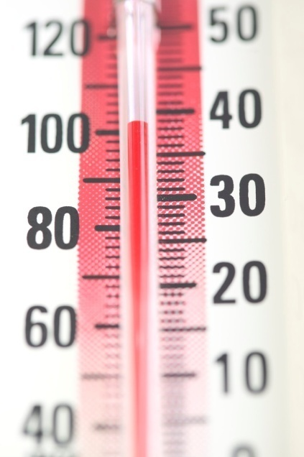
Store chocolate and chocolate products
Store at correct temperature and conditions
Closed environment
No air movement
Low humidity
Cool temperature 15°C to 18°C
Minimal handling
Notes:
Trainer to advise:
Chocolate products are susceptible to damage easily
They are a delicate product
If humidity is too high water condensation will appear on surface and cause chocolate to go grey
Keep covered
Keep cool
Low humidity environment
Less than 50% is preferred

Slide 28
Store chocolate and chocolate products
Maintain eating quality, appearance and freshness
Make in small quantities
Use best quality ingredients
Store in low humidity environment
Handle with gloved hands
Notes:
Trainer to advise:
Best way to maintain eating quality is to use best quality ingredients and to make in small batches
Make often
Appearance; to keep their gloss chocolates must be stored in low humidity environment
Handling; handle with gloved hands as oil in skin leaves residue mark in gloss on chocolates

